Slide 1
A ‘Tiered approach to secondary transition in Dacorum’
Rob Weightman
V2 Spring 2025

Slide 2
Why? The starting point…
-Use/ extension of previous successful PPG work…
Previous experience of secondary transition arrangements... Including supporting those children/ families of higher need
-Responses of parents in the Tudor Primary school community…
Other points to note:
-Number of reduced hours timetables in year 6 that are not transferred/ transitioned to year 7
-Permanent Exclusion evidence raised at DESC:

Slide 3
Impact! Early days but positive indicators…
Delivery:
Secondary schools all agreed to the approach
Secondary schools have responded proactively to questions/ challenges
Feedback shares a true willingness to work in partnership
88%* of responders think it has had a positive impact on approaches to transition (*source- Dacorum Transition Conference)
Data:
Over 25% reduction in PXs for the same period (19-2023/2024, 14- 2024/2025)
No PXs in year 7 or 8 at all so far whereas 5 in the same period last year

Slide 4
Idea- link to: ‘Tiered Approach to Emotional Wellbeing and Behaviour Strategy’
Working in partnership to benefit from:
shared language
awareness of what to do sequentially
recognition of different levels of support
‘bespoke’ signposting
exemplars of good practice
Increased partnership between schools for transition/ post transition
a ‘shared understanding’…

Slide 5
Tiers
Universal
Universal +
Targeted
Targeted +

Slide 6
Universal
visit from year 7 lead to primary group
summer school opportunities
transition day for all
secondary school parent meeting new parents
taster evening for parents after school allocation
September start in school with just year 7
monitoring of engagement from parents for transition activities
Autumn visit from primary lead/ head to secondary to speak to pupils (cohort dependent)
ongoing named person at secondary (eg form tutor)

Slide 7
Universal +
extra transition day for targeted pupils
enhanced signposting for support
additional transition opportunities of lone movers
secondary school coffee mornings for parents in advance of year 7
visit with primary member of staff
sharing of phone support between primary and secondary

Slide 8
Targeted
supported visit to secondary with SENCo/ INCo
secondary SEND visit TO primary setting
home visits when required
additional specialist contact (pastoral) for family

Slide 9
Targeted +
structured meeting with secondary lead and family* (*with advocate if required)
meeting between primary and secondary leads/ DSLs (professionals meeting)
-creation of agreed transition targets and actions (formal)
weekly/ monthly meeting for family and secondary member of staff/ lead
-where EHCPs are in place, secondary school to attend year 6 EHCP review
Extra tier? ‘Specialist’
-DESC transition support*
*previously identified pupils

Slide 10
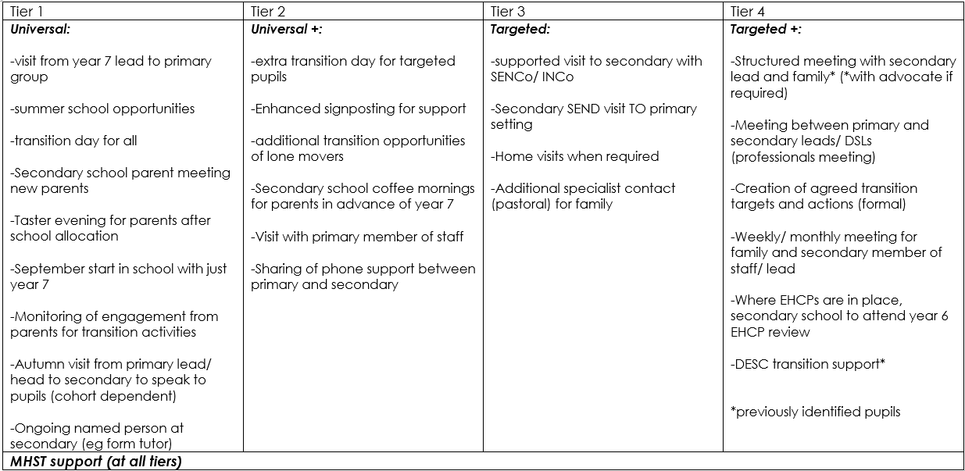

Slide 11
Tiers (and how many children in a class of 30 ‘could’ be in each one?)
Whilst cohorts can certainly differ with each year, it is appropriate to share some general guidance on the ‘likely’ numbers for each tier. Both primary and secondary schools will only have a limited capacity to respond. This project is about effectively and efficiently identifying those higher levels of need:
Universal - the vast majority of children 20-25 per class
Universal + - 5-10 children per class
Targeted - 1 or 2 per class…
Targeted + - 1 per class… or maybe even 0!
Please continue to note that the transition tiers are NOT necessarily related to SEND. Let’s ensure we use that detailed knowledge/ partnership/ understanding that we have been able to build over an extended period of time with the children and their families.

Slide 12
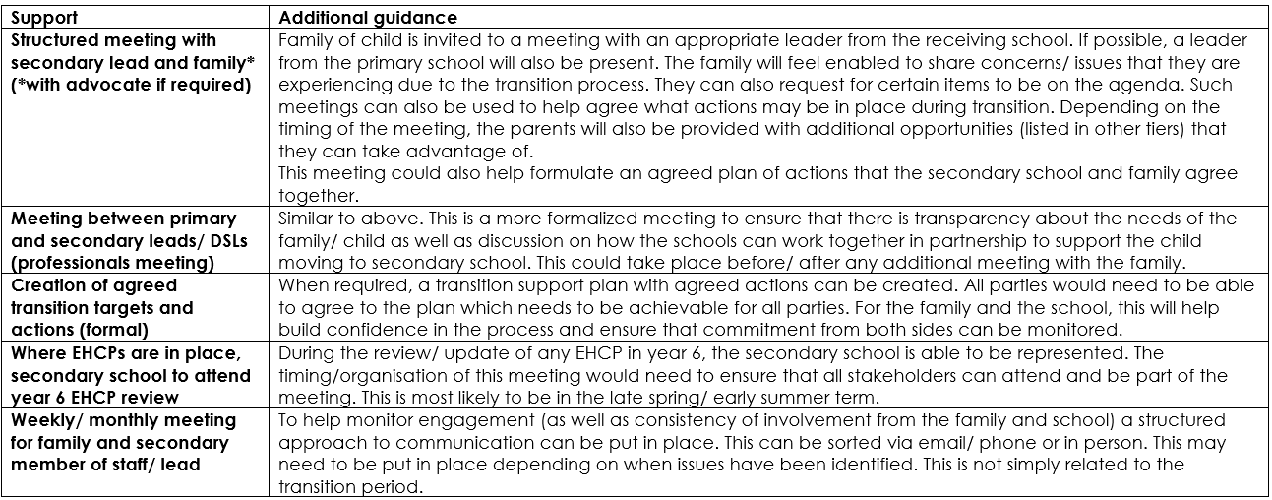
Examples of strong practice- exemplars…

Slide 13
‘Transition in Tring’
Whereas there are a number of separate schools in fairly close proximity in Hemel Hempstead, Tring School is the chosen school for most children in Tring. Currently, it is evident that there is more interaction and partnership already in place between most schools in this area. This includes:
Focus transition opportunities as part of the regular year 6 provision
Tring School teachers delivering activities/ working alongside primary schools during the summer term
Use of an agreed transition matrix for sharing of information between the schools to help identify potential adjustments to regular practice
Regular (and open) dialogue between school leaders
Access to enhanced information about the needs of pupils/ families
Whilst such practice may be easier to deliver due to Tring’s single secondary school, similar approaches could be delivered/ used in Hemel Hempstead.

Slide 14
Ensuring we work in partnership with secondary schools
All secondary headteachers involved have agreed:
a commitment to investing in the project
to use the language shared within the project
to inform their transition leads to engage with the approaches
Secondary headteachers request the following:
Due to previous experiences of families NOT engaging with schools if their allocated school was not the one they wanted, some children have not been enabled to benefit from enhanced support. Primary headteachers are asked to actively encourage families to work WITH the allocated school. Such transition support will still be beneficial even if this not where the child ends up.
Primary school to ensure that the secondary school is aware of any current use of reduced hours timetables.

Slide 15
What next?
Recognition that approach has now been shared (and agreed) with Dacorum primary and secondary headteachers
Sharing of tiers/ approaches for KS1 transition into KS2 can also take place
Use the language/ tiers when identifying pupils/ sharing information for 2024 transition
DSPL lead to share expectations with individual secondary schools and check understanding of new approach
DSPL lead to seek lead teacher for KS1/KS2 transition- action any required adjustments/ changes
Continue to discuss more efficient/ effective/ consistent approaches to sharing of key information
Enable parents to understand/ recognise what they could/ should expect
Awareness/ recognition that tiers are not necessarily related to factors such as SEND/vulnerability, etc
Develop some approaches to moderation of level of need for ‘tier descriptors’
Evaluate impact of tiered transition support in Autumn 2024- action any changes needed

Slide 16
Making it work…
Primary schools to identify appropriate tier for transition of children in 2024:
Primary and secondary leads to use the language/ tiers when identifying pupils/ sharing information for 2024 transition (there is no expectation to use any specific/ additional proforma or paperwork)
Primary and secondary schools to provide appropriate capacity for supporting children/ families to benefit from approach
A commitment to an appropriately enhanced focus on those children/ families who will benefit from additional support/ intervention
Discuss more efficient/ effective/ consistent approaches to sharing of key information
Support parents to understand/ recognise what they could/ should expect. Encourage investment from families in regard to their allocated, even if family is awaiting appeal/ awaiting different allocation
Develop some approaches to moderation* of level of need for ‘tier descriptors’
Commitment to more interaction/ discussion/ support between primary and secondary headteachers post transition

Slide 17
Even better when… (Feedback from 2024 transition)
Feeling enabled to challenge when the expectations are not being met (contact secondary head/ transition lead)
Challenging inappropriate demands from primary schools. EG- schools asking for transition support for a complete year group
Clear identification of those children/ families on Targeted/ Targeted + and having these PRIORITISED in transition meetings (challenge when schools work through a ‘list’)
Recognise the limited capacity we all have. Focus on what is NEEDED
Get the right people in the room:
-Having the headteacher/ senior leader present in the transition meetings- especially when discussing the targeted/ targeted + children and families
-Recognising that the year 6 teacher may not necessarily have all the required knowledge
Sharing a willingness for continued dialogue/ conversation/ partnership with the secondary school post transition
Engaging in transition support activities offered by the secondary school

Slide 18
Thank you…
This project has been put together to support the children and families of Dacorum.
All those involved in the development of the approach appreciate anything you can do to support it. Thank you.

Slide 19
Project contributors
Dacorum primary headteacher support group
Helen King- Team Leader at Dacorum MHST (Mental Health Support Team)
Graham Cunningham- Headteacher- Longdean
Debbie Bailey- Deputy Head- JFK
Kathryn Girdlestone- DESC- Outreach and Therapeutic Services Lead
Jenny Bramley- DESC- Outreach support worker
Katherine Elwood- Headteacher, Chair of behaviour and wellbeing sub-group, DHC lead headteacher
Ruth Mason- DSPL 8 Manager
DSPL8 board
DHC and DASH
Lucy Williams – AHT Tring School- Y7 integration
Rob Weightman- Headteacher- Tudor Primary School

