Slide 1
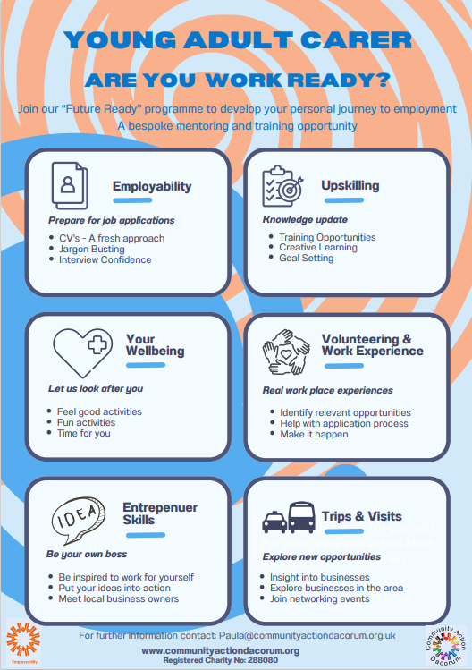
Future Ready; An Employability Project for Young Adult Carers

Slide 2
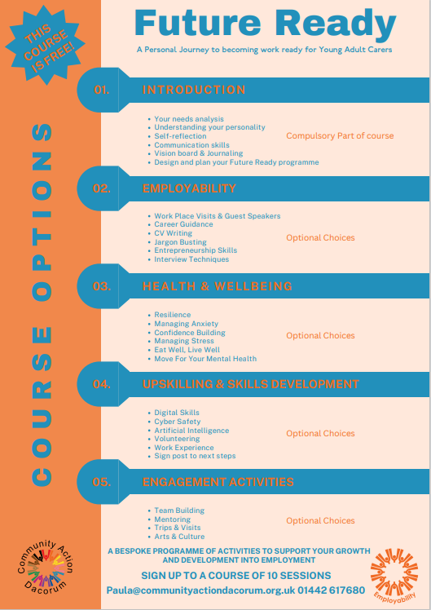
What is it?
A bespoke needs led programme to help Young Adult Carers to become work ready.
A programme of one to one or small group sessions. Online or face to face to suit the individual.
Who is it for?
For 18–24-year-olds with caring responsibilities living in the Dacorum Area.
For 18 – 24year-olds who are not yet in employment or further Education.
Expected Outcomes
To become more confident, resilient and improved wellbeing.
To become work ready – with updated CV, knowledge and experience.

Slide 3
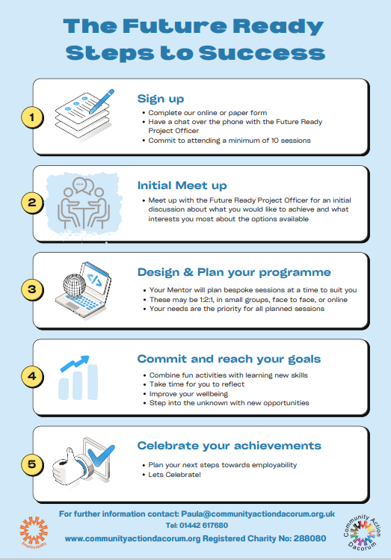
What are the expectations?
Young Adult Carer will attend a minimum of 10sessions
Young Adult Carer will work with the mentor to design a bespoke programme of learning activities to suit their needs
The programme is free to attend

Slide 4
For more information please email: paula@communityactiondacorum.org.uk
Or sign up via the qr code

