Slide 1
Why have an Emotional Wellbeing and Behaviour Offer?
To reflect and complement the HCC Emotional Wellbeing and Behaviour Strategy
Hertfordshire’s emotional wellbeing and behaviour strategy
No previous formalised support for social, emotional and mental health needs in Early Years in Hertfordshire
Historically supported by the Early Years SEND team, but increase in service demand have reduced capacity to provide the level of support needed
Rise in the number of children receiving fixed or permanent exclusions or subject to a manage move in Nursery, Reception and Year 1 in the last three years
Anecdotally, we know there are children moving between multiple settings as needs cannot be met
Early intervention is always best

Slide 2
Our Vision
Early Years practitioners in Hertfordshire will have a greater knowledge of the underlying causes of social, emotional and behavioural needs and will be able to confidently use therapeutic techniques to support and develop emotional wellbeing and promote pro-social behaviour
All children in the Early Years will have a secure, stable and happy placement at a setting close to their home and of their choosing. They will have a positive attachment to a key adult and will be supported to develop meaningful relationships with their peers.
Key transitions will be effectively planned and supported to meet the individual needs of the child, setting the foundations for a successful onward placement

Slide 3
I would like to access the virtual Child Minder Drop-in session but how?
Do you have a child in the Early Years who you have concerns around their emotional wellbeing and behaviour (please note, this offer is not for SEND but EWB)?
Do parents share your concerns? If so, please complete a single service request.

Slide 4
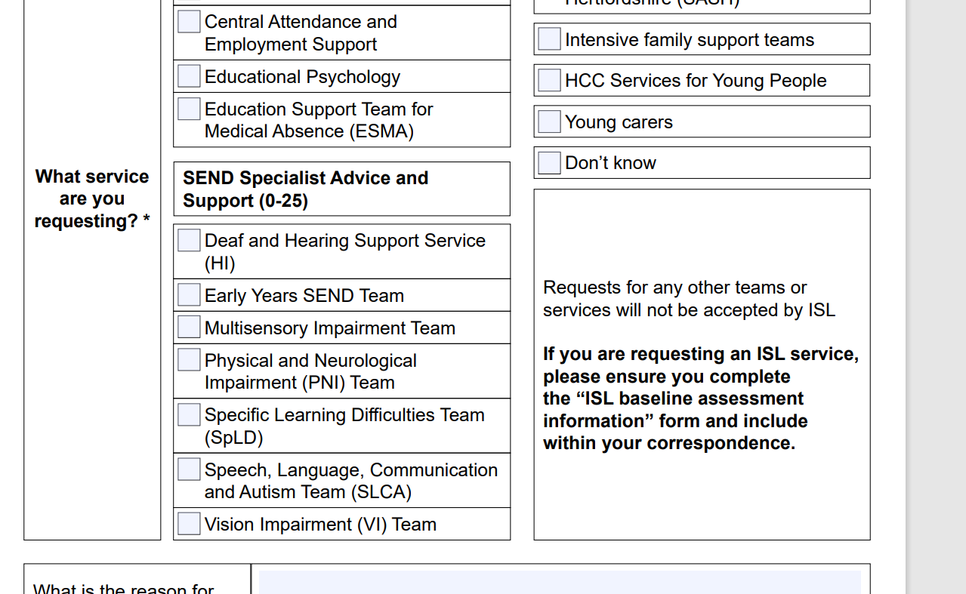
Tick the EY SEND BOX and on the form state that its EY EWB drop in session that you are requesting
https://www.hertfordshire.gov.uk/media-library/documents/childrens-services/counselling-in-schools/singleservicerequestform.pdf

Slide 5
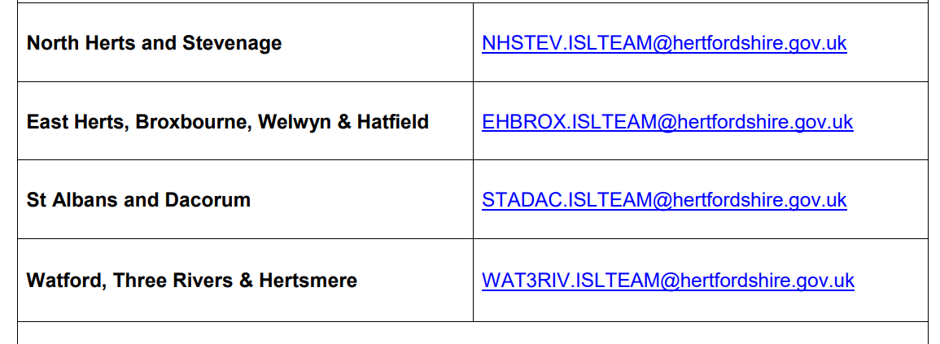
Once the SSR is completed (with parental signature), please send to your areas mailbox via herts FX. If you do not have a Herts FX please email your areas mailbox and request a Herts FX invite. You will then be able to set up an account.

Slide 6
Please then email the tab@hertfordshire.gov.uk mailbox stating that you have sent in a SSR and would like to arrange a child minder drop-in session.

